Slide 1

Avian Coccidiosis+ Trichomonas Infection + Histomoniasis
Prepared by Dr. Harith Abdulla Najem
College of Veterinary Medicine – University of Basrah

Slide 2
Avian coccidiosis is a protozoal disease caused by Eimeria spp., with 9 important species affecting chickens including E. tenella and E. necatrix (highly pathogenic), E. acervulina and E. maxima (moderate), and others with milder effects. Infection occurs mainly at 3–6 weeks of age, although all ages can be affected depending on immunity and management.
Transmission is through ingestion of sporulated oocysts via the fecal–oral route, especially under conditions of high humidity, poor litter management, and high stocking density. Clinically, birds show diarrhea (sometimes bloody), reduced growth, and decreased production, while lesions are site-specific within the intestine, ranging from mild enteritis to severe hemorrhage, particularly in the ceca with E. tenella.st quote that reflects your approac
Economic importance:Mortality.Retarded growth.Cost of drugs.
Conditions needed for maturation of oocyst:
Temperature (28°C).Moisture (high humidity).Oxygen (O₂).

Slide 3
Avian Coccidiosis
Acute gut infection in chickens and turkeys.
All avian species are affected.
Host specific.
Etiology : Protozoa.
Genus : Eimeria .
Poultry raised on the floor are highly susceptible
than those raised on wire floor.
Mature Oocyst is the infective stage of the parasite.
Oocysts are resistant to the environmental conditions.

Slide 4
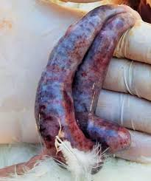
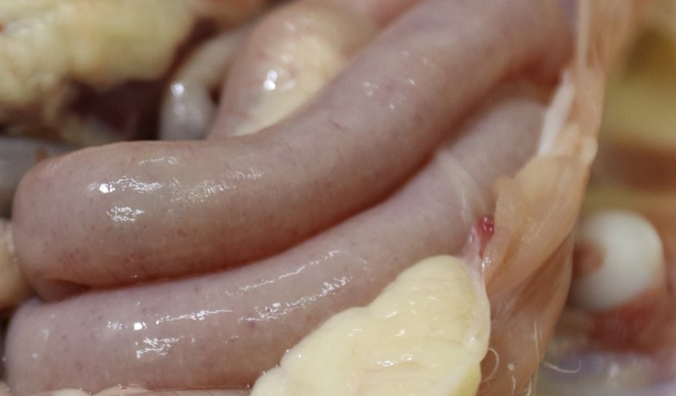
Species affecting chickens
1-Eimeria necatrix Post-mortem lesions
a. Ballooning in mid gut
.b. White spots and petechial hemorrhages (“salt and pepper” appearance on serosal surface).
c. Gut filled with mucoid bloody exudates.d. Sausage-like intestine.e.
Severe necrosis.
2. Eimeria tenella (Cecal coccidiosis)
a. Erosion of cecal wall.
b. Free blood and bloody cores in ceca.
c. Caseous cores in old cases.
d. Petechiae.
e. Thickening and ecchymoses.

Slide 5
3. Eimeria brunetti (Ileorectal coccidiosis)
a. Infection in lower small intestine and rectum.
b. White area with thickening of lower small intestine and rectal walls.
c. Coagulative necrosis and mucoid bloody enteritis in the lower gut.
d. Petechiae.
e. Severe necrosis.
4. Eimeria maxima
a. Faint hemorrhage and wall ballooning.
b. Blood-tinged mucus or orange exudates.
c. Petechiae and thickening of middle third of intestine.
d. Mild to severe enteritis.

Slide 6
5. Eimeria acervulina
a. “Ladder-like” lesions produced by white plaques (oocysts) in the duodenum.
b. Thickening and petechiae.
6. Eimeria mivati
a. Occurs in epithelium of the upper gut (duodenum).
b. Lesions similar to Eimeria acervulina.
7. Eimeria mitis
a. Occurs in upper third of small intestine.
b. Difficult to see any lesion.
c. Slight mucoid appearance.
8. Eimeria praecox
a. Causing diarrhea.
b. Excess liquid and mucus in duodenal loop.
9. Eimeria hagani
=

Slide 7
Diagnosis:
Clinical signs:
a. Diarrhea.
b. Sudden death of well-fleshed birds.
c. Blood-stained feces (bleeding).
Post-mortem changes.
Examination of fecal sample with light microscope for detection of oocysts.
Histopathology.
Treatment:
Amprolium: drug of choice, administered in drinking water.
Sulfonamides (e.g., sulfadimidine, sulfamethazine).
Toltrazuril: highly effective anticoccidial, used in drinking water.
Diclazuril: potent anticoccidial with strong efficacy against Eimeria spp.

Slide 8
1. Trichomonas Infection:
Avian trichomoniasis is a disease of young birds. Adult birds that recover from the infection may still carry the parasite, but are resistant to reinfection. Trichomonas gallinae is a common parasite of pigeons and doves. Other birds such as domestic and wild turkeys and chickens may also become infected.
Trichomonas gallinae is generally found in the oral–nasal cavity or anterior end of the digestive and respiratory tracts.
Transmission:
From bird to bird through:
a. Carriers.
b. Contaminated water and feed.
c. Wild pigeons and other birds.

Slide 9
(Short):
Clinical signs
Adults (acute): Sudden death with minimal signs.
Young birds: Yellowish-white nodules in oral cavity, esophagus, and crop (suggestive of trichomoniasis).
General signs: Anorexia, weight loss, ruffled feathers, dullness, weakness, imbalance, ± diarrhea.
Outcome: Death may occur within 3 weeks.
Post-mortem lesions (young):
Small white–yellow lesions in mouth (soft palate).
Inflammation and ulceration of mucosa.
Cheesy material in mouth and crop.
Large necrotic masses may block lumen.
May spread to liver and other organs.
Adults None

Slide 10
Diagnosis:
Microscopic examination of greenish fluid and cheesy material.
Characteristic lesions.
Prevention:
Culling or treating carrier birds.
Clean food and water regularly and protect from contamination by wild pigeons and other birds.
Treatment:
Antiprotozoal medications such as dimetridazole and metronidazole.
Avian trichomoniasis is caused by Trichomonas gallinae and mainly affects young birds.
It spreads via contaminated water, feed, and carrier birds.
Signs include caseous oral lesions, anorexia, and weight loss.
Diagnosis by lesions/microscopy; treatment with metronidazole.

Slide 11
Histomoniasis (Blackhead):
Disease of chickens and turkeys caused by Histomonas meleagridis, affecting ceca and liver.
Transmitted via Heterakis gallinarum (cecal worm).
Also spread through earthworms acting as carriers.
Infection occurs after ingestion of infected eggs or worms.
Clinical signs (Histomoniasis):
Depression, inappetence, and poor growth.
Sulphur-yellow diarrhea.
Cyanosis of head (blackhead).
Blood in feces (chickens).
Progressive emaciation.

Slide 12
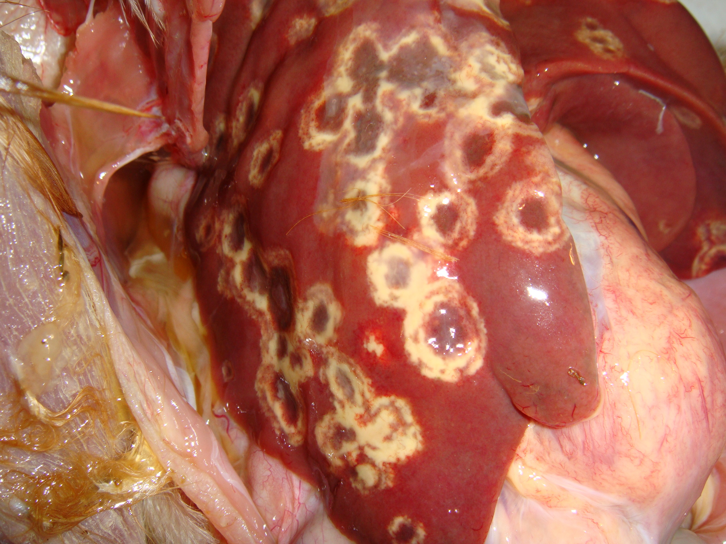
Post-mortem lesions (Histomoniasis):
Enlarged ceca with ulcers and caseous cores.
Yellow–grey–green areas in ceca.
Liver with round depressed grey lesions (may be absent early).
Diagnosis:
Lesions + scraping from fresh material for microscopic examination.
Prevention:
Good sanitation, avoid mixing species, use anti-histomonas products in feed.
Treatment (Histomoniasis):
Nitro-imidazoles (e.g. dimetridazole).
Nitrofurans (e.g. furazolidone, nifursol).
Arsenicals (e.g. nitarsone).

